Slide 1
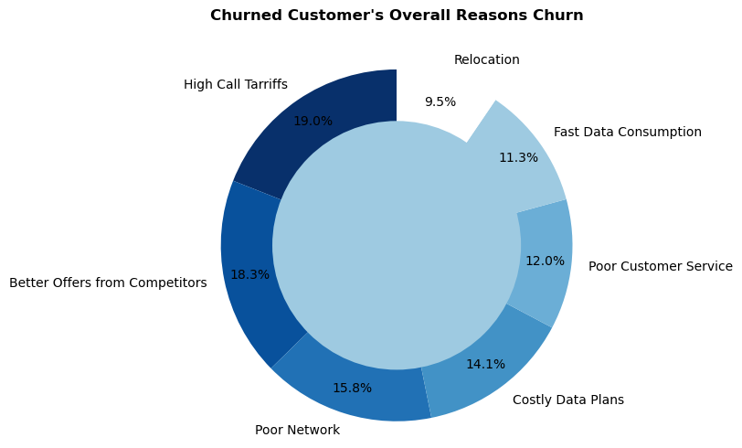
CUSTOMER CHURN AND RETENTION
29.2
70.8
31.4
Churn Rate (%)
Retention Rate (%)
Average Customer Tenure (Months)
Insights and Actions
53% of the total churn came from just the top 3 “Reasons for churn”, of which High Call Tariffs was major.
Reducing Call tariff would better enhance customer experience and increase the Retention rate by 19%.
Offer flexible pricing plans that cater to diverse customer needs and preferences.
Continuously monitor competitor’s offers, promotions and marketing strategies.
Upgrade and expand network infrastructure to improve coverage, speed and reliability.
JAN – Mar (2025)
MTN CUSTOMER CHURN
1

Slide 2
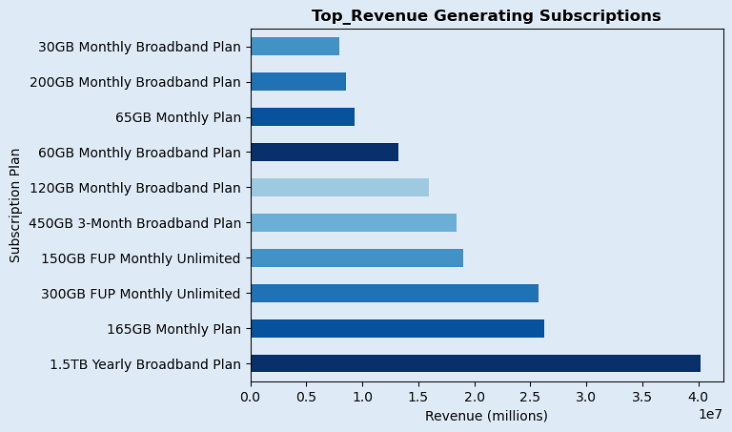
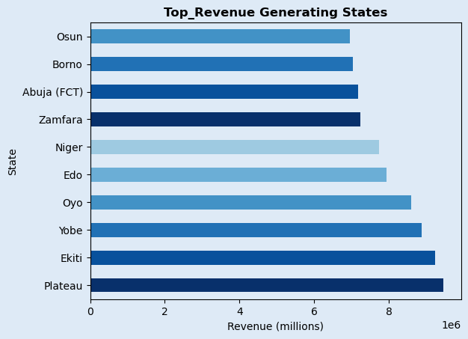
REVENUE AND FINANCIALS
#199M
#205,000
Total Revenue
Average Revenue
JAN – Mar (2025)
MTN CUSTOMER CHURN
2

Slide 3
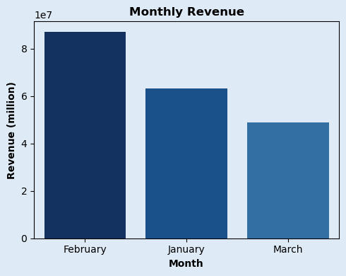
REVENUE AND FINANCIALS
#199M
#205,000
Insights and Actions
Total Revenue
Average Revenue
The 1.5TB yearly broadband plan generated the most revenue despite it‘s limited customer base.
Prioritize customer retention strategies on these customers, utilize targeted advertising, offer loyalty programs so as to maintain strong relationships
Constantly iterate and improve this product, so as to meet evolving customer needs
February experienced a 27% rise in revenue, as a result of huge customer churn due to Better offers from Competitors, this revenue dropped by 50% in March.
Thorough analysis of competitors offers should be conducted, including pricing features, and benefits so as to identify areas where competitors are outperforming. This could help retain up to 39% of churned customers
Also, review and adjust pricing strategy to remain competitive.
27%
50%
JAN – Mar (2025)
MTN CUSTOMER CHURN
3

Slide 4
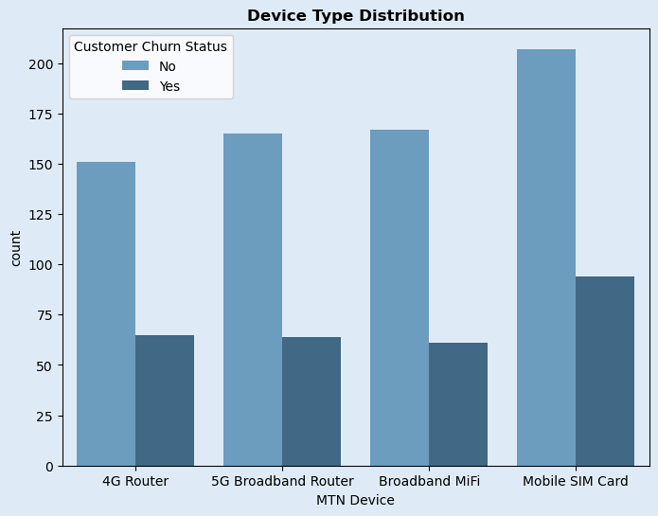
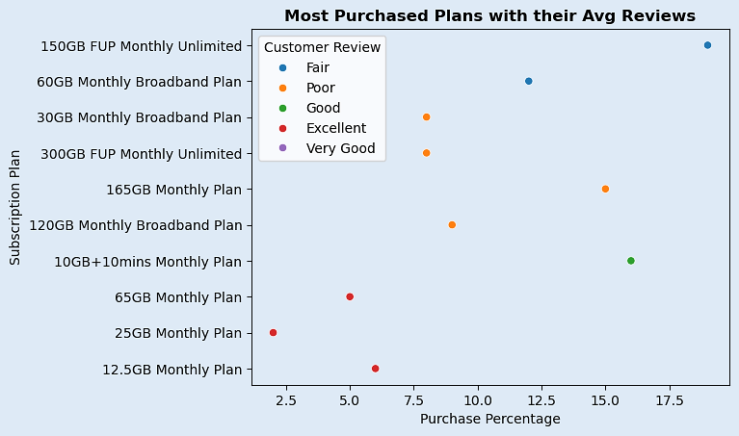
CUSTOMER BEHAVIOUR & SATISFACTION
99.3GB
Very Good
Mobile SIM Card
Average Data Usage
Overall Avg Review
Most Used Device
Up to 40% gave
Poor reviews
JAN – Mar (2025)
MTN CUSTOMER CHURN
4

Slide 5
CUSTOMER BEHAVIOUR & SATISFACTION
99.3GB
Very Good
Mobile SIM Card
Average Data Usage
Overall Avg Review
Most Used Device
Insights and Actions
Among the most purchased subscription plans, 40% of customers gave poor reviews, Better offers from competitors was a major reason behind this churn
Mobile SIM Card users had the most purchases, retention but also had the most churn, this also was due to offers from competitors issues
Develop and improve upon areas of weakness such as poor network, high tariffs, poor customer service to retain customers and remain competitive.
JAN – Mar (2025)
MTN CUSTOMER CHURN
5

Slide 6
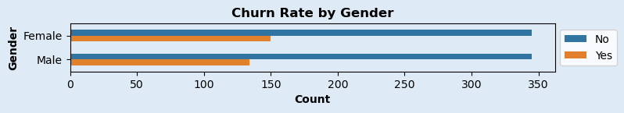
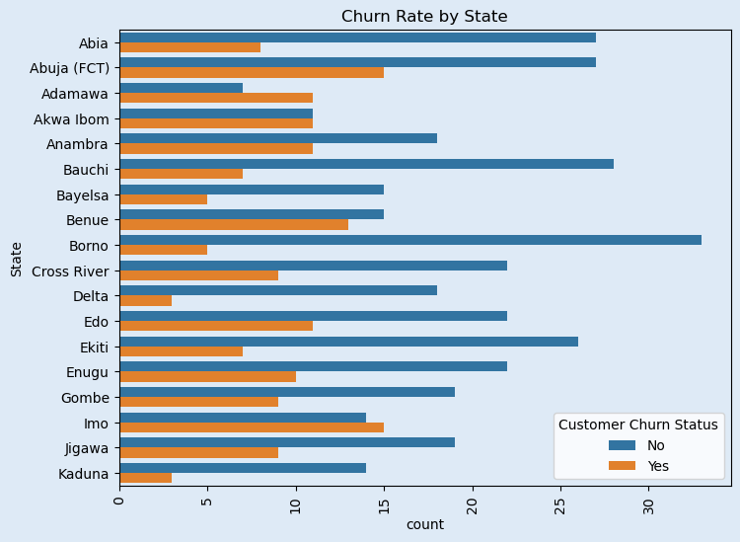
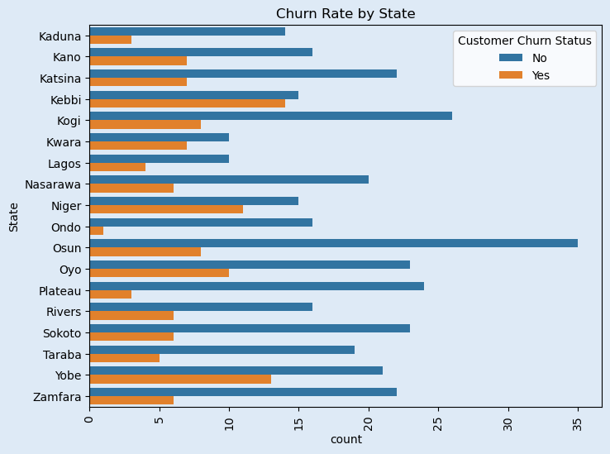
DEMOGRAPHIC INSIGHTS
Female: 495
Male: 479
JAN – Mar (2025)
MTN CUSTOMER CHURN
6

Slide 7
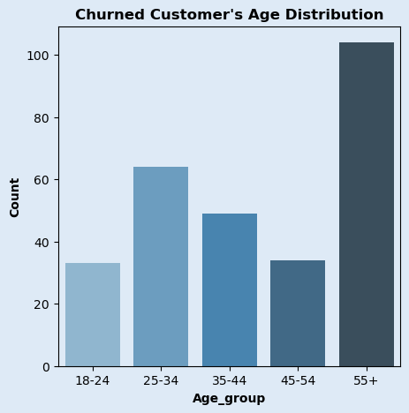
DEMOGRAPHIC INSIGHTS
Insights and Actions
In Age groups and Gender Categories with high churn, Better offers from competitors, Poor Customer service High tariffs and Poor network were highly responsible for the churn.
The company’s pricing strategy, network quality, and customer service need improvement to retain this customers.
Provide customer service training offer multi-channel support, and foster a positive work environment.
States like Abuja, Imo and Kebbi had huge experience huge customer churn, Relocation, Costly data plans, and Poor network were the major causes of this.
Invest in upgrading network infrastructure to improve coverage and quality.
Offer flexible plans and packages that cater to customer needs and budgets.
JAN – Mar (2025)
MTN CUSTOMER CHURN
7

